Slide 1
Causal effects due to social networks

Slide 2
Background
Assortative mating: observation of increased phenotypic similarity between couples compared to random pairs.
People tend to choose partners more similar to themselves.
Unknown to what extent couples converge and influence each other over time.

Slide 3
Possible convergence paths

Slide 4
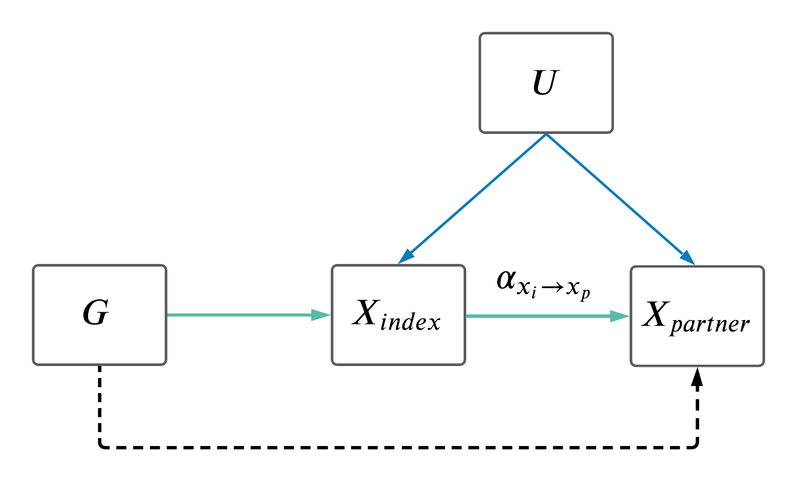
Theory: causal effects in mating pairs
Effect due to assortative mating and convergence

Slide 5
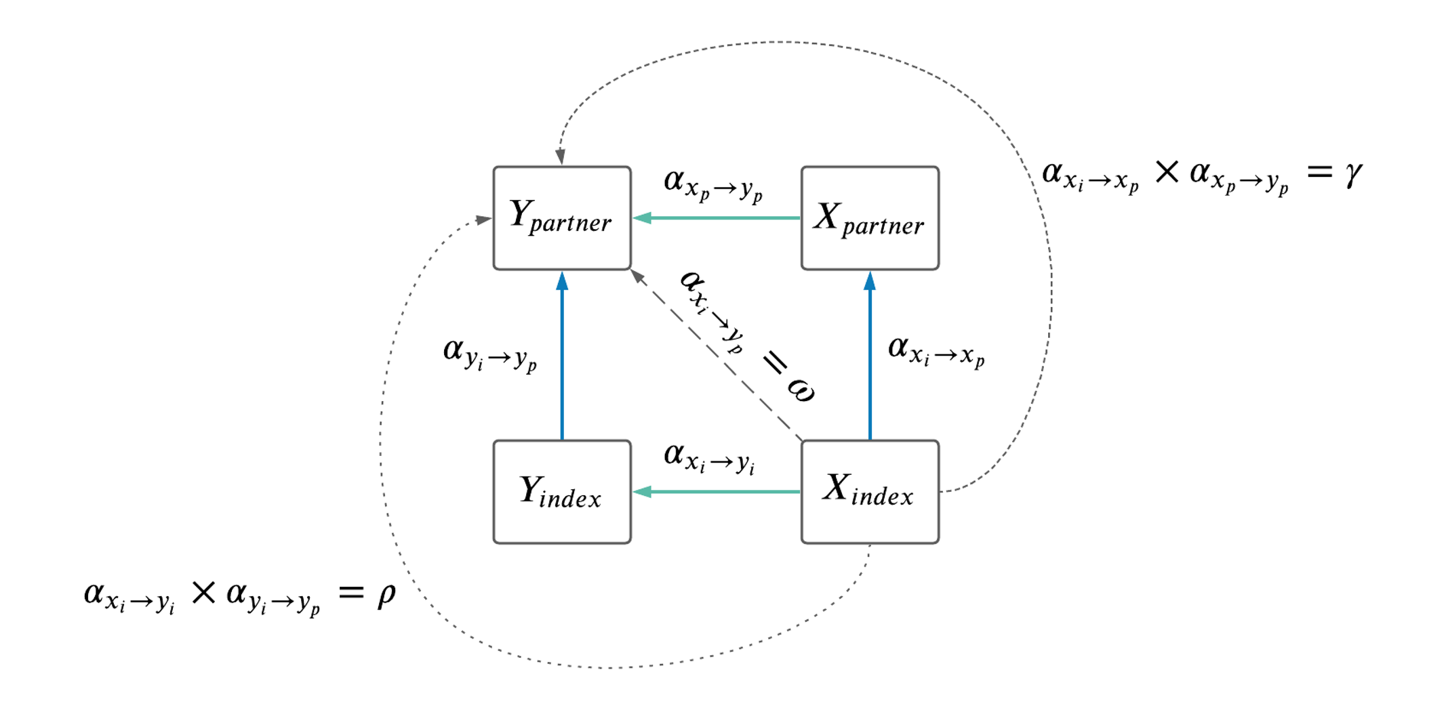
Two trait MR model

Slide 6
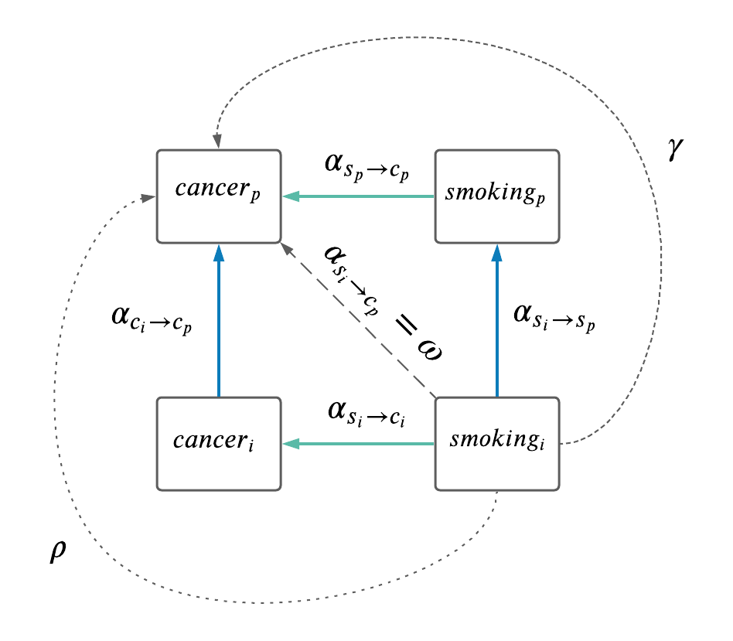



Slide 7
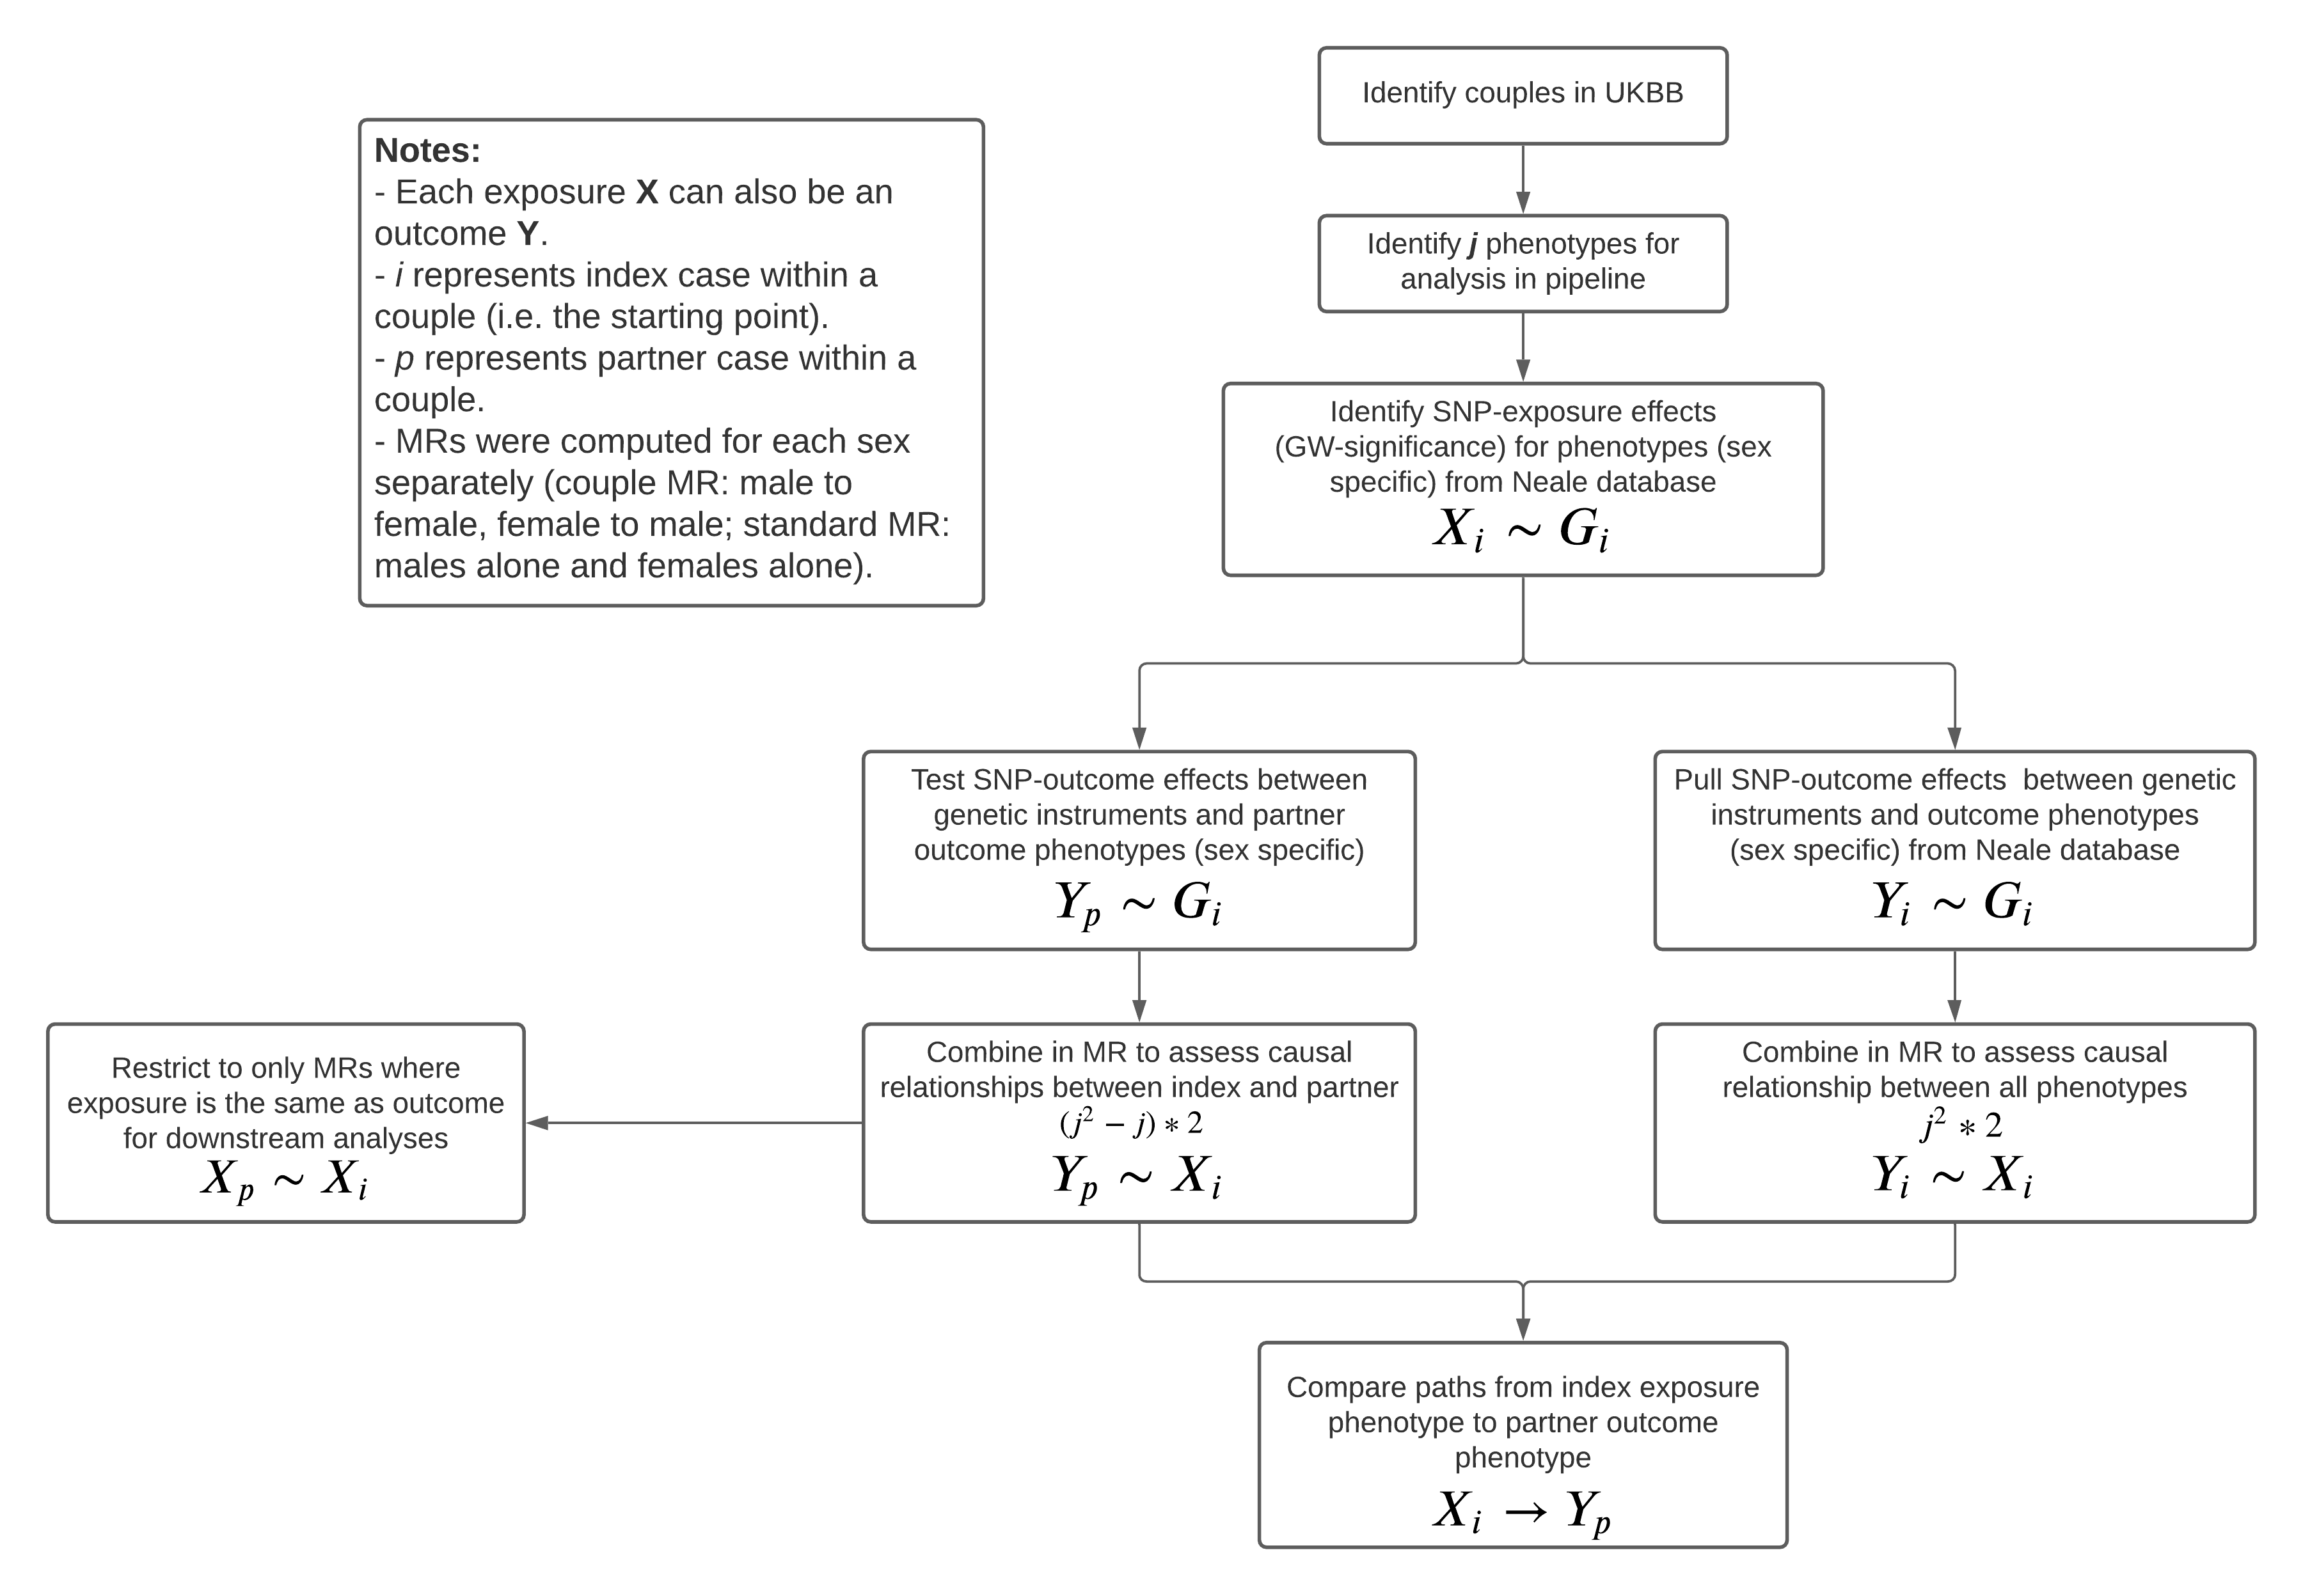
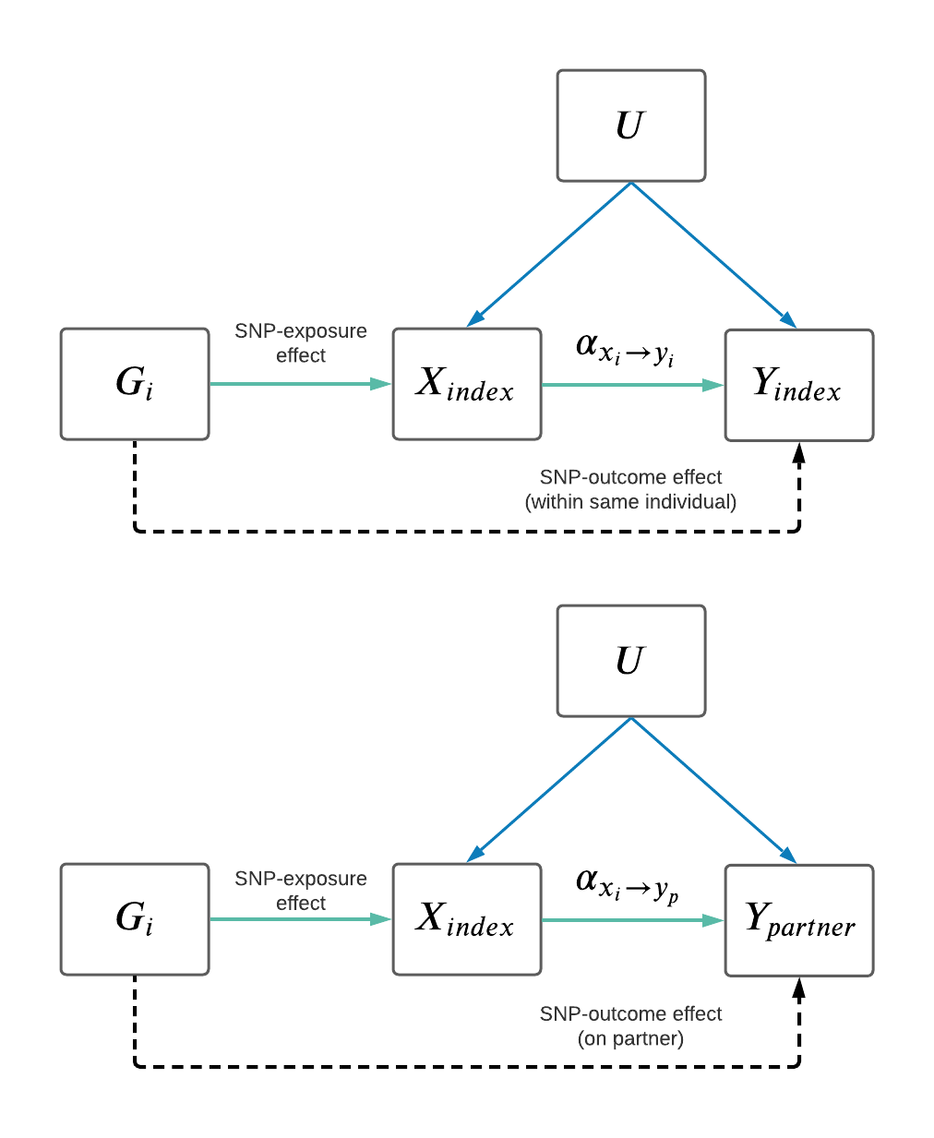
Pipeline overview

Slide 8
Pipeline overview

Slide 9
Pipeline overview

Slide 10

Pipeline overview
$$X_{partner}$$

Slide 11
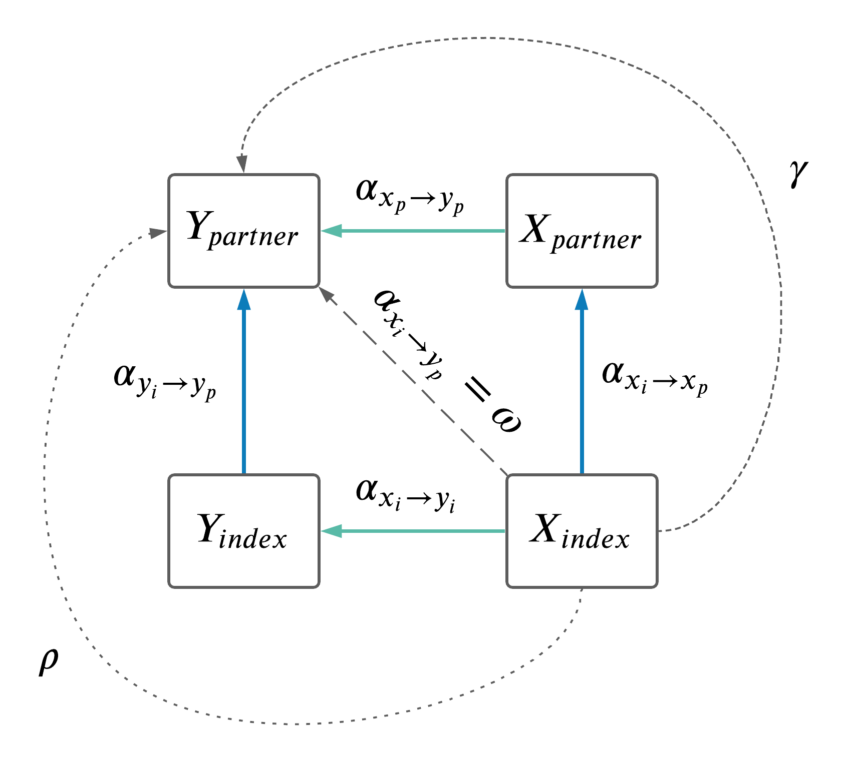
Pipeline overview

Slide 12
Pipeline overview

Slide 13
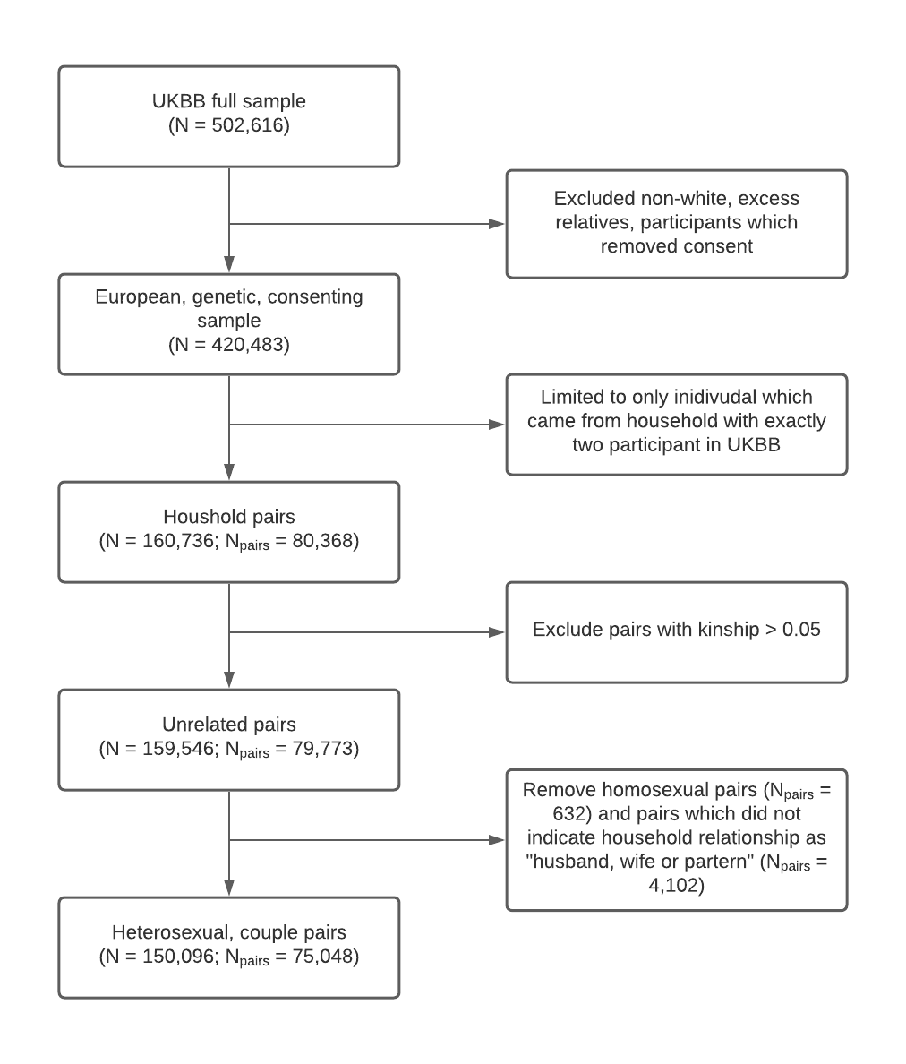
Couple identification in the UKBB

Slide 14
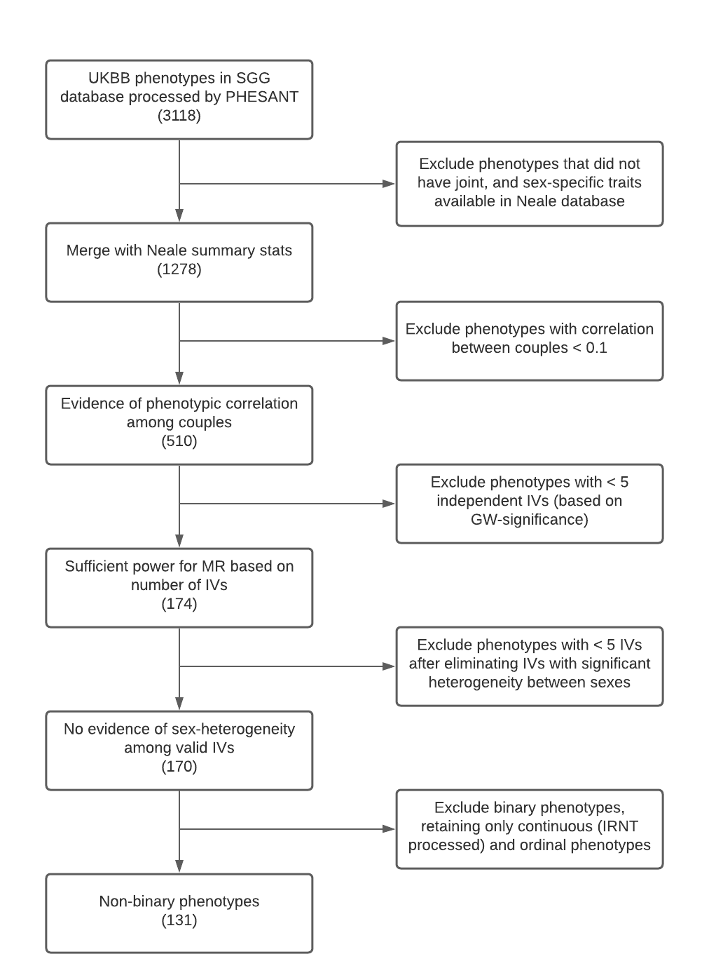
Phenotype selection in UKBB

Slide 15
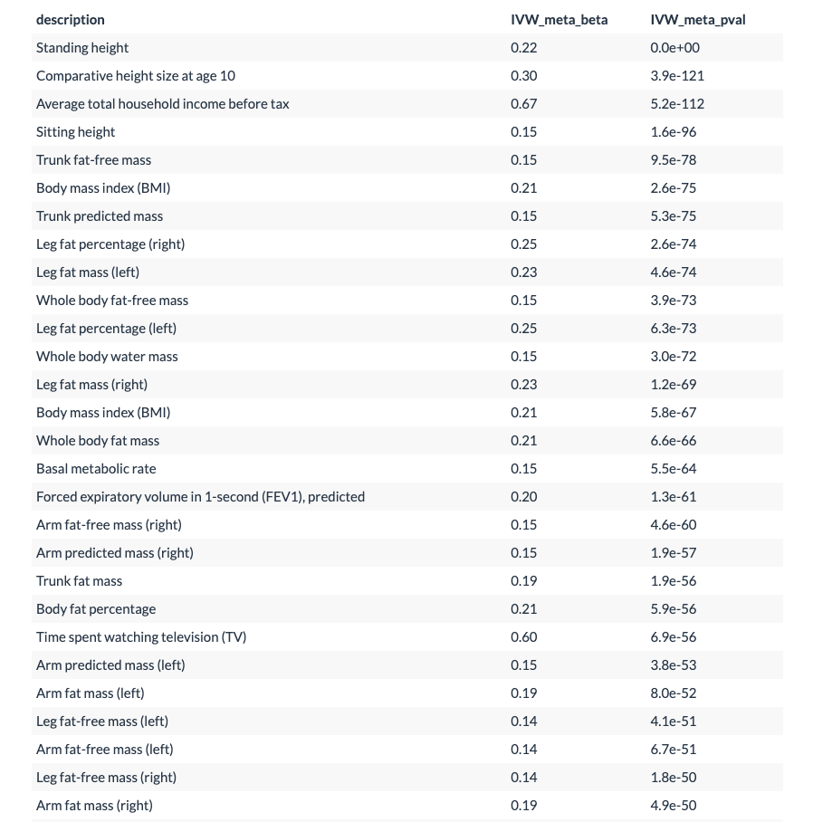
AM mendelian randomization results
131 phenotypes tested.
80 significant after adjusting for multiple hypothesis testing (using PC adjustment).
Of these 80:
1 showed significant difference between sexes.
2 showed significant pattern across time spent together.

Slide 16
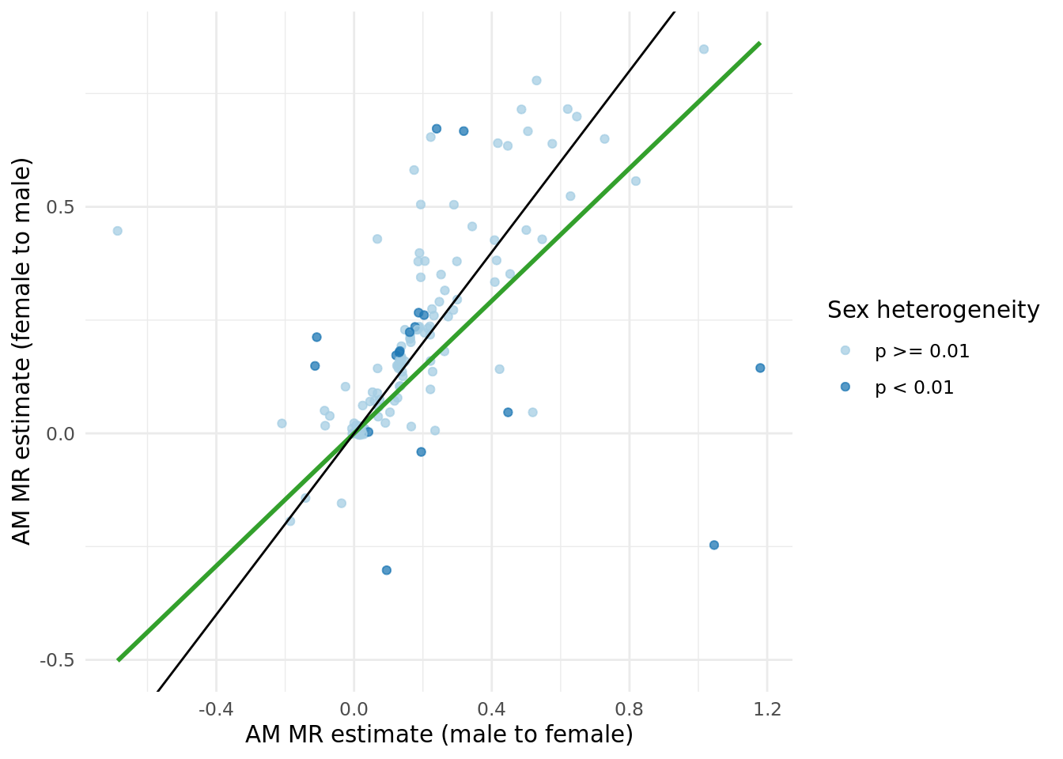

Assortative mating MR ($X_{i}→X_{p}$), sex-differences
Notes:
An example of sex-difference AM result. Sex = exposure sex. Females are more “choosy” compared to males.

Slide 17
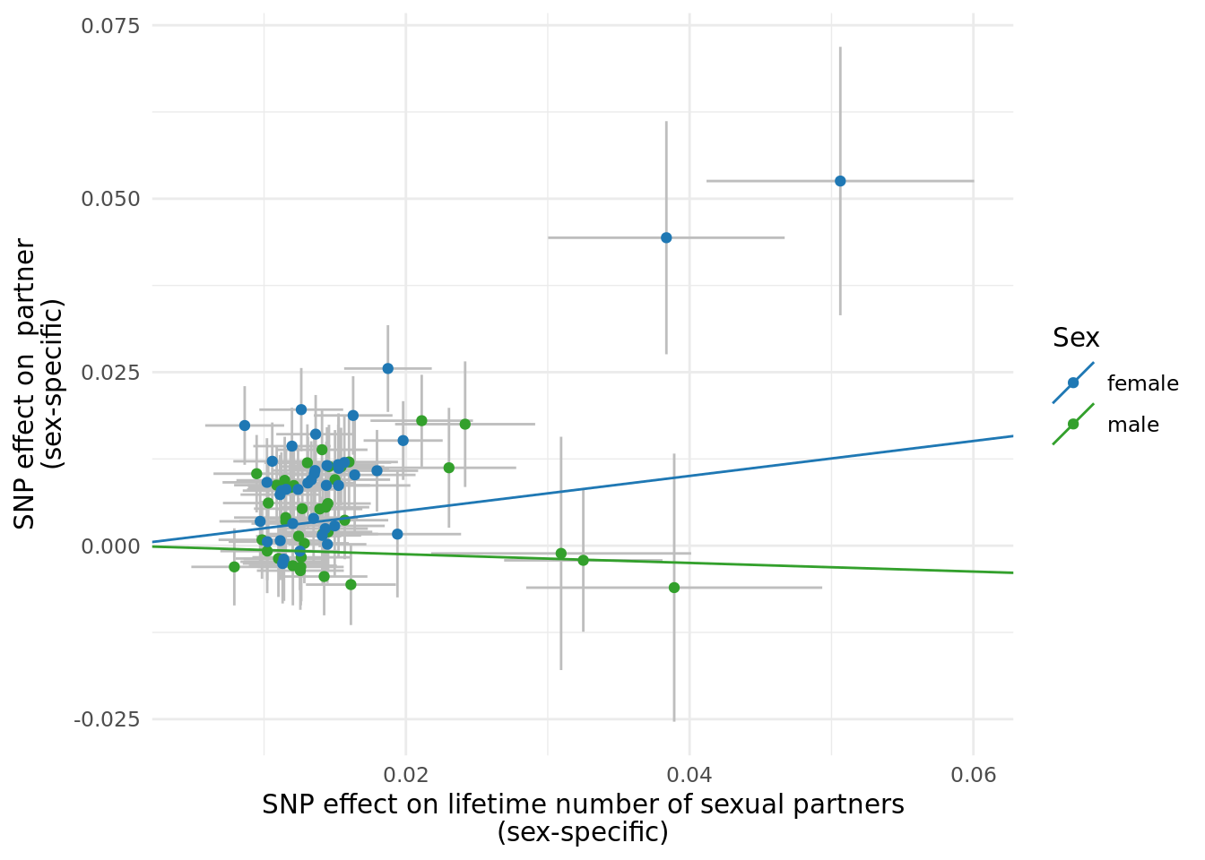
Assortative mating MR ($X_{i}→X_{p}$), sex-differences
Notes:
An example of sex-difference AM result. Sex = exposure sex. Females are more “choosy” compared to males.

Slide 18
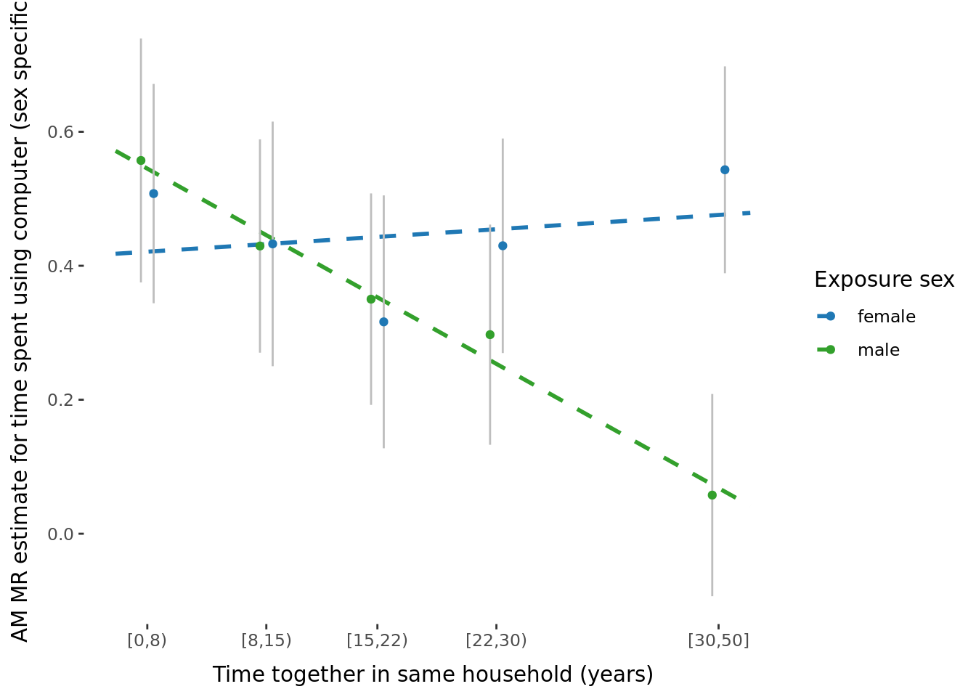

Assortative mating MR ($X_{i}→X_{p}$), impact of time-together
Notes:
With more time together, females are less likely to be similar to the male partners with respect to tabacco smoking (perhaps just picking up quitting patterns)

Slide 19
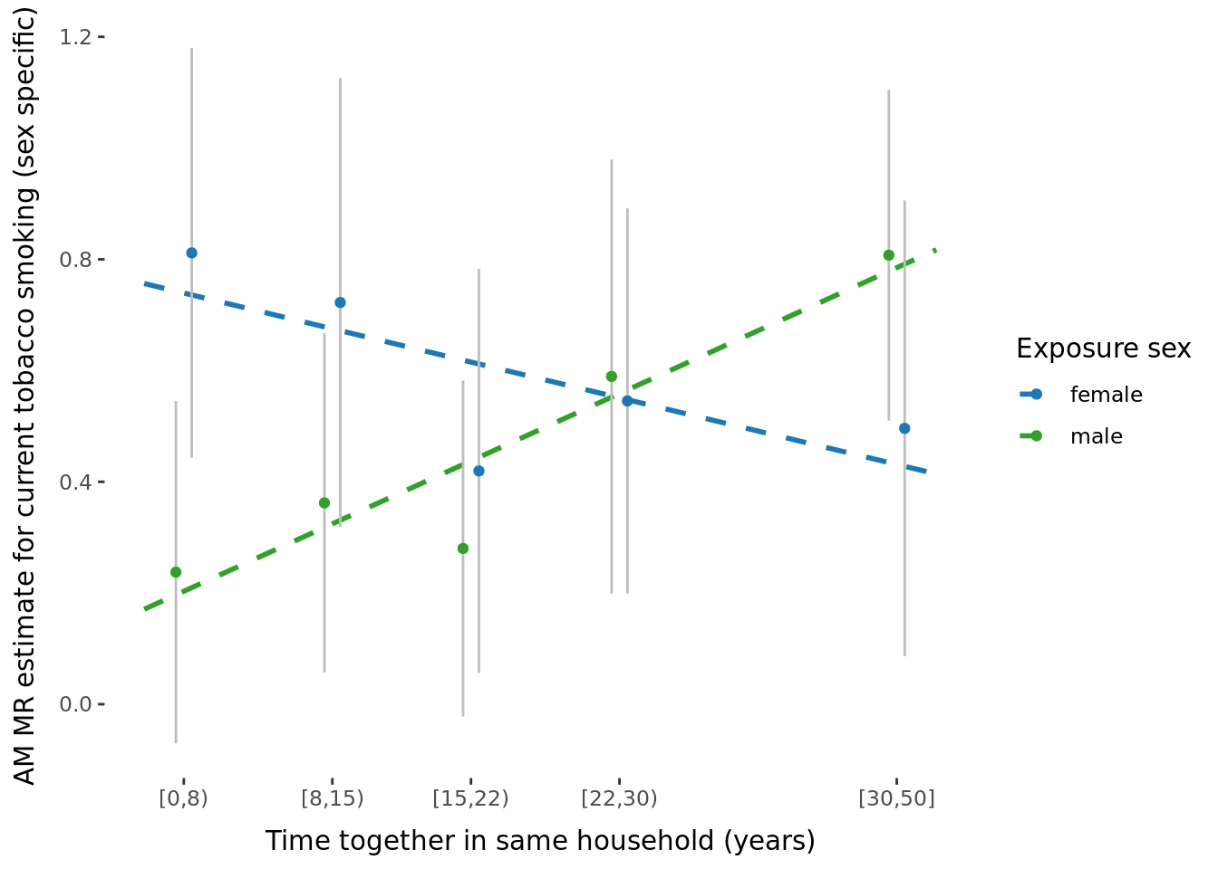
Assortative mating MR ($X_{i}→X_{p}$), impact of time-together
Notes:
With more time together, females are less likely to be similar to the male partners with respect to tabacco smoking (perhaps just picking up quitting patterns)

Slide 20
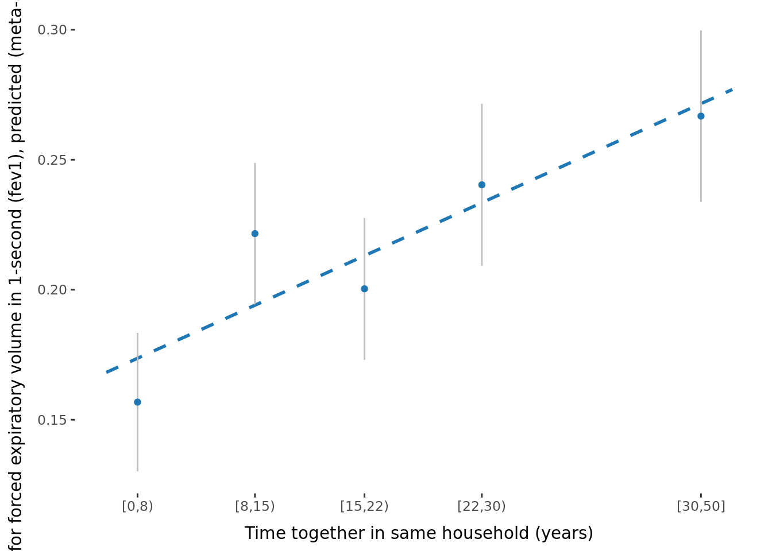
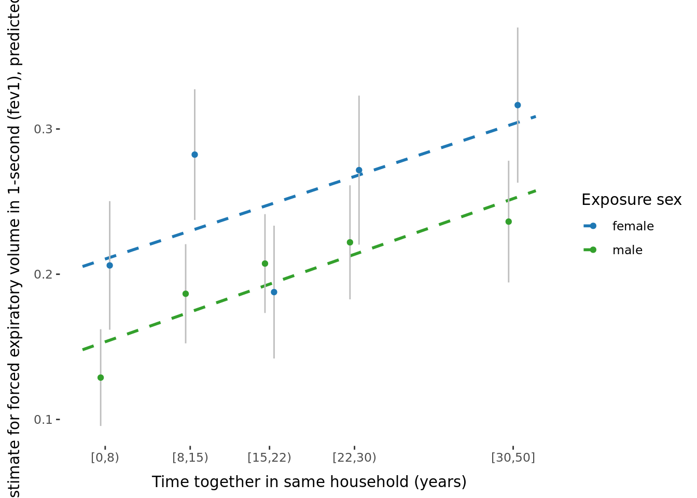
Assortative mating MR ($X_{i}→X_{p}$), impact of time-together
Notes:
With more time together, females are less likely to be similar to the male partners with respect to tabacco smoking (perhaps just picking up quitting patterns)

Slide 21
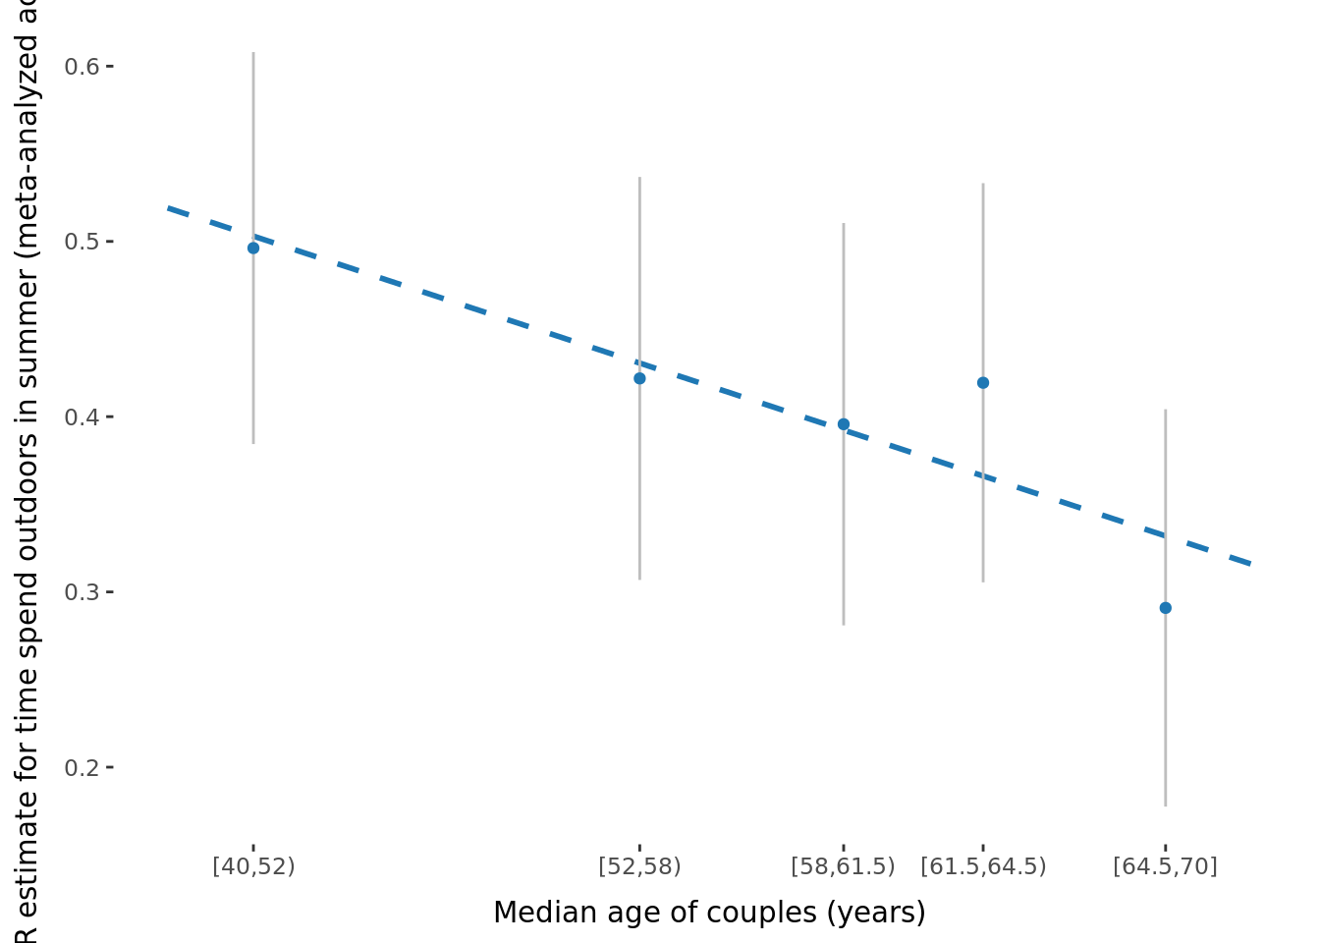
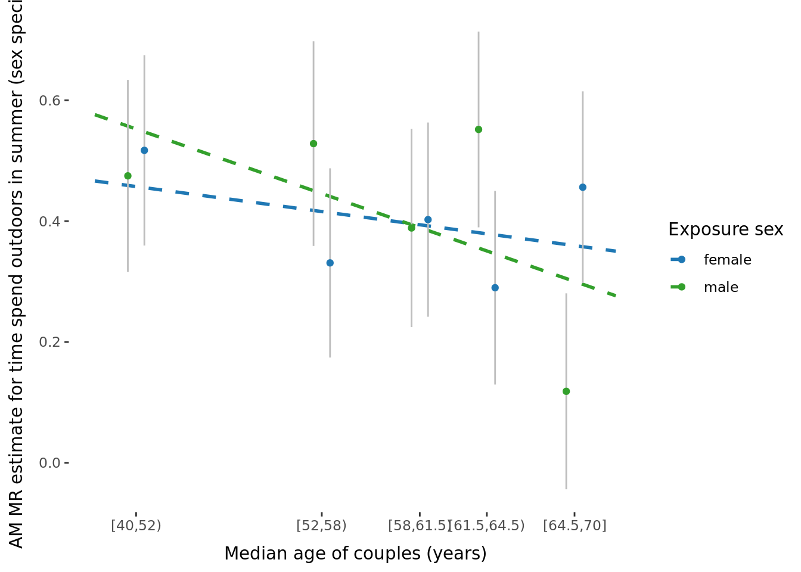

Assortative mating MR ($X_{i}→X_{p}$), impact of age
Notes:
With more time together, females are less likely to be similar to the male partners with respect to tabacco smoking (perhaps just picking up quitting patterns)

Slide 22
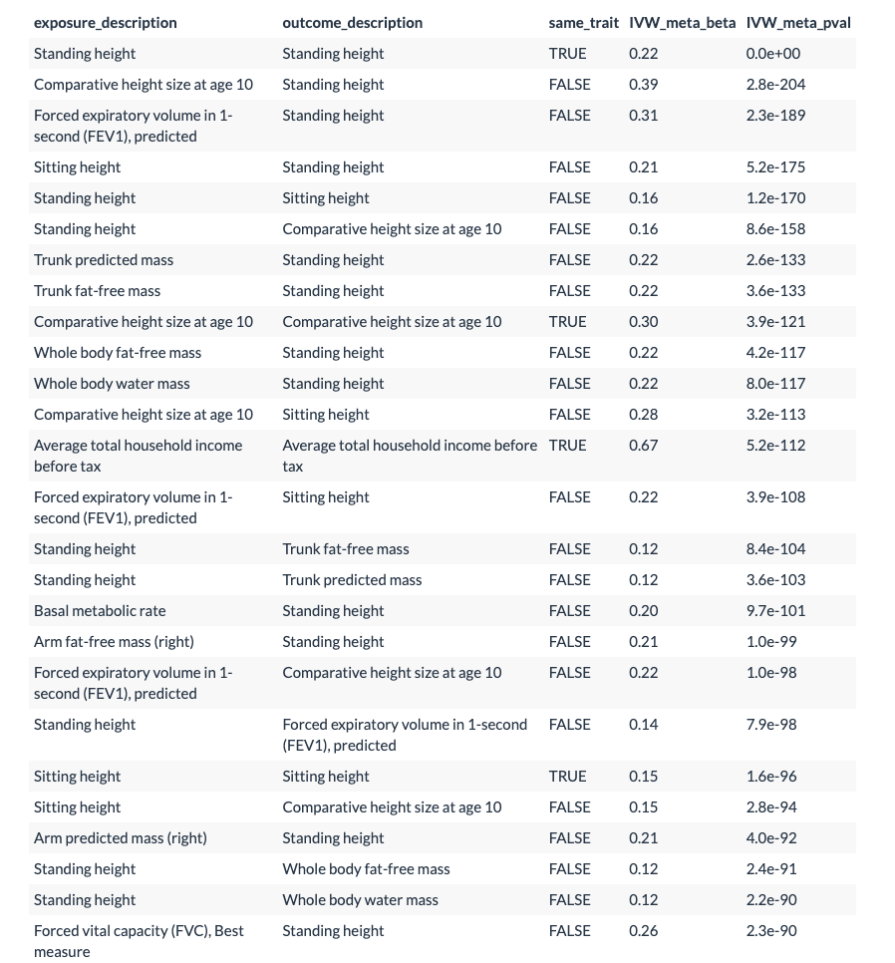
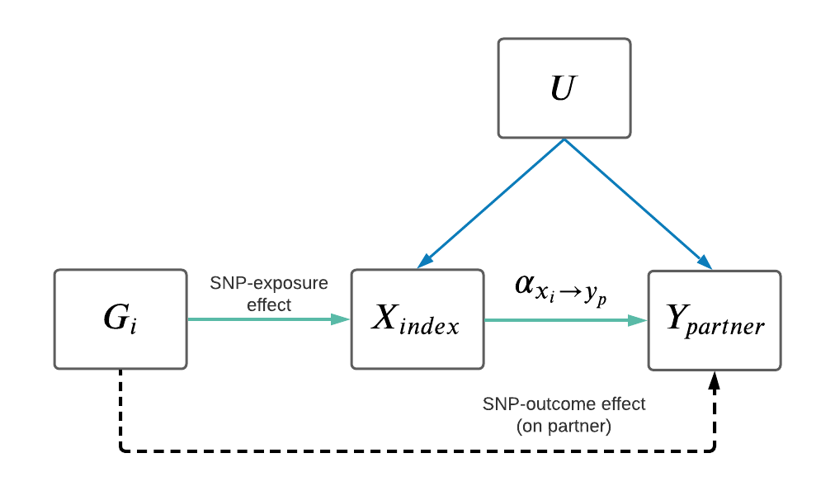
Two-trait mendelian randomization results
131 phenotypes tested.
131² MRs (x 2, one for each direction: M ➡ F and F ➡ M).
After meta-analyzing across sexes, 1965 significant after adjusting for multiple hypothesis testing (p < 0.05/131²)

Slide 23
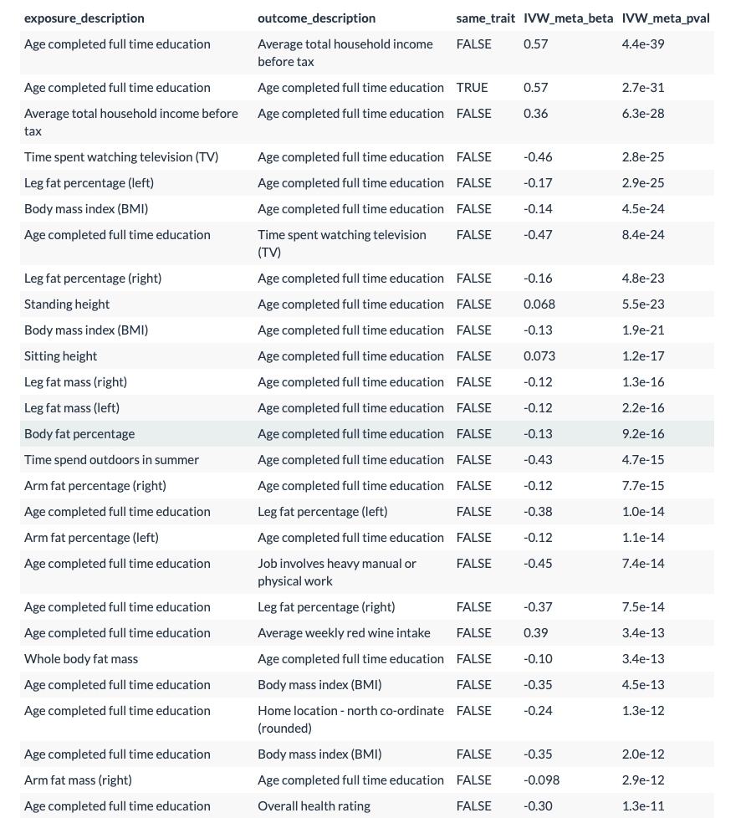

Slide 24
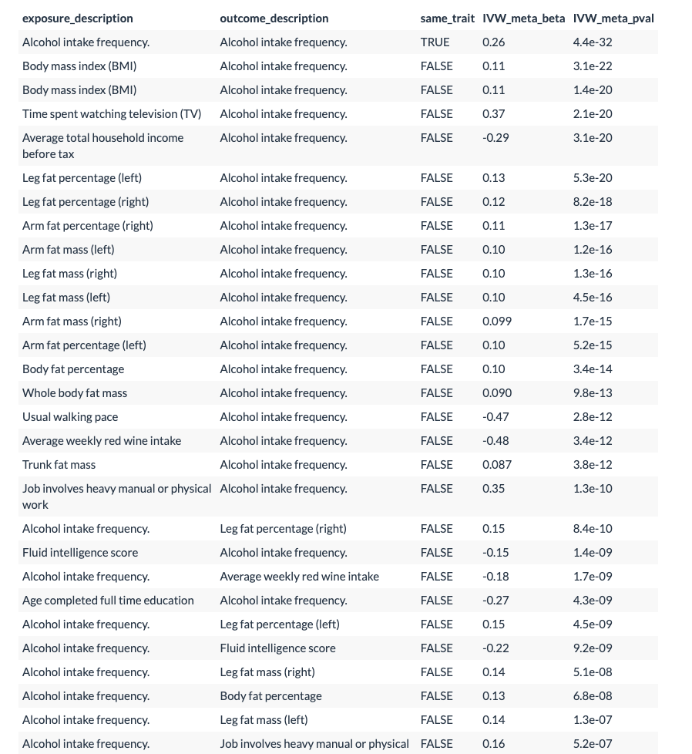

Slide 26
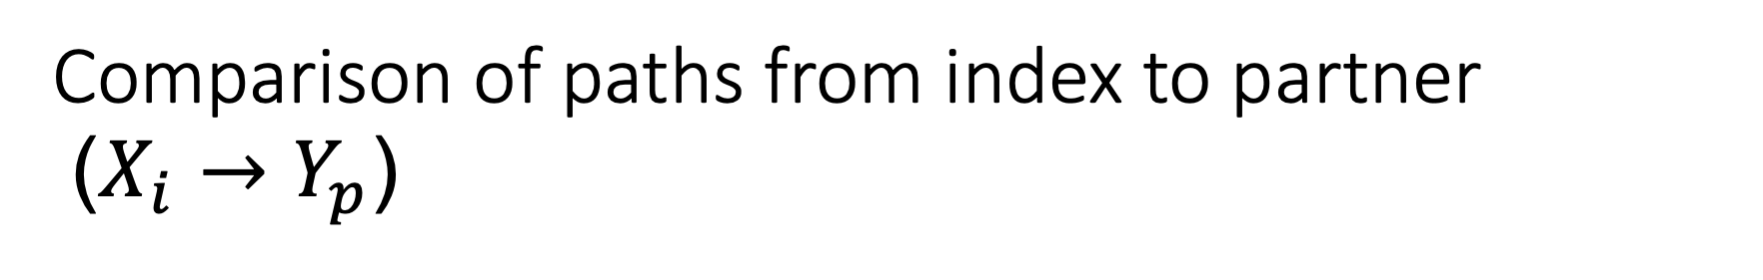
Comparison of paths from index to partner ($X_{i}→Y_{p}$)
Notes:
Examined 131*131 traits (each dot represents an X,Y pair). X/Y pairs were limited to showing evidence significance in a same-person MR model (i.e. standard MR). In general, gamma is favored over rho (i.e assortative mating occurs through X not Y).

Slide 27
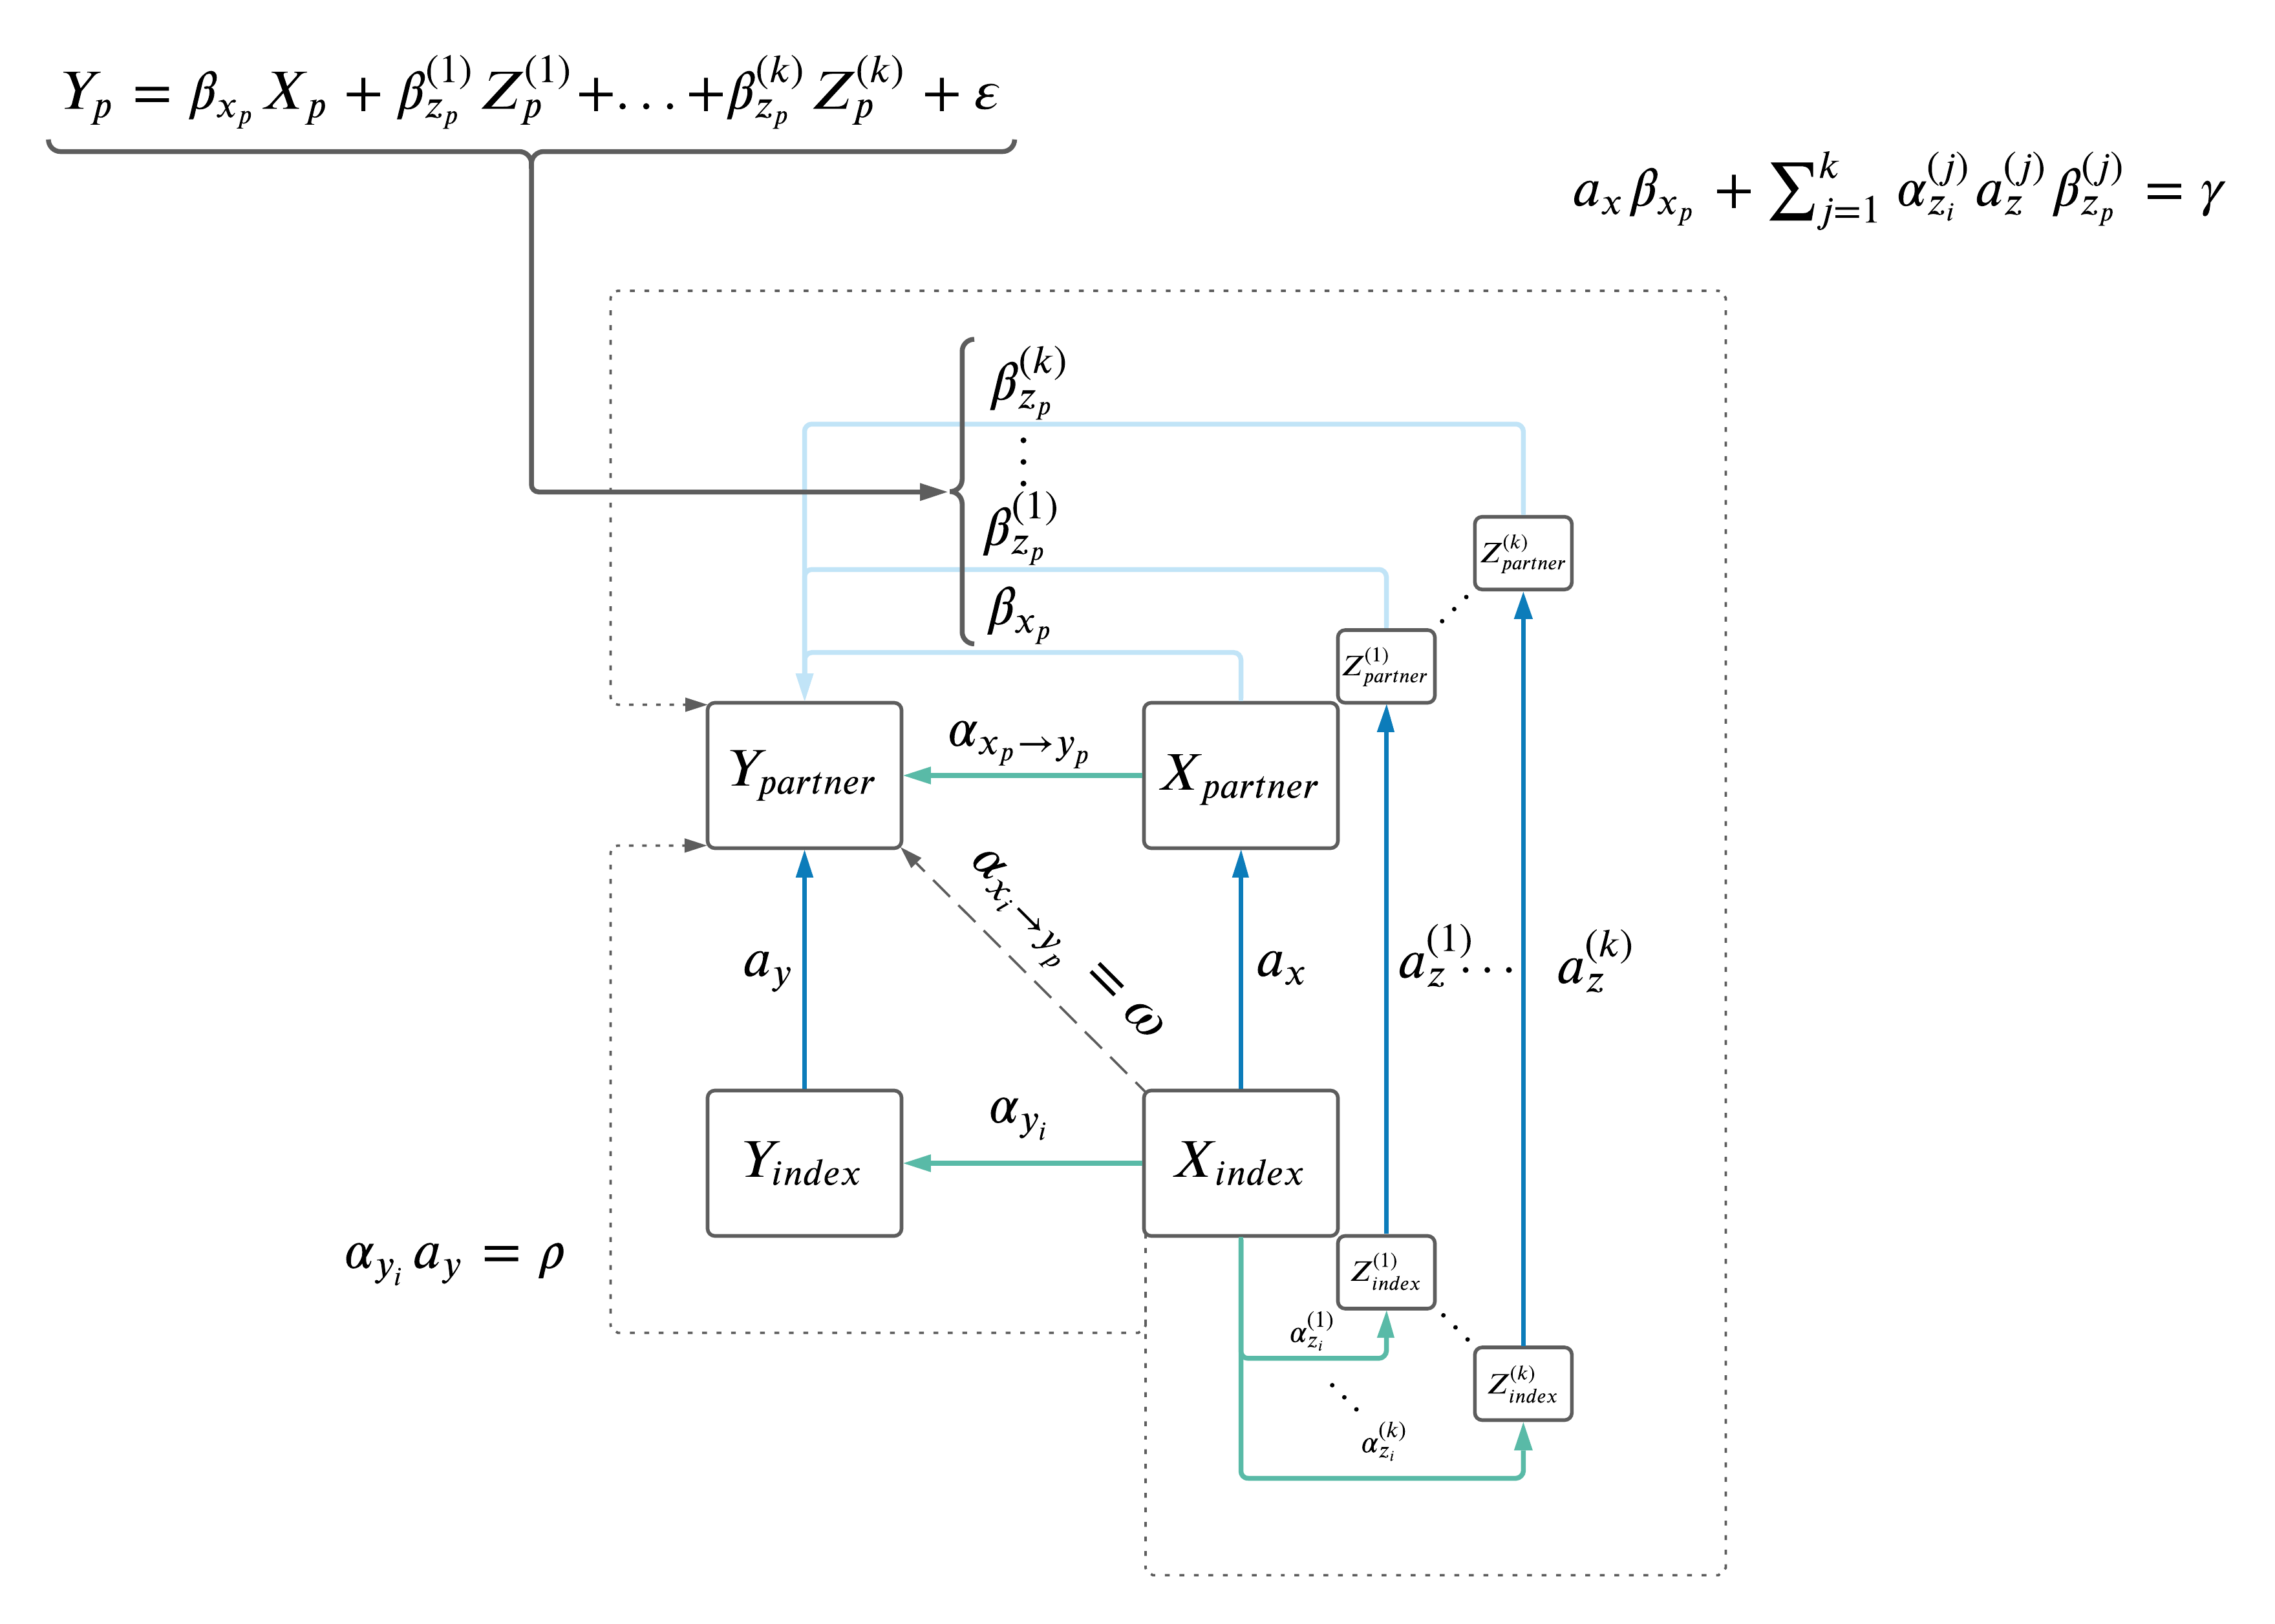
Expanded model allowing for indirect effects

Slide 28
Next steps
Expand to MV model to allow for indirect effects.
Include dietary summary variables?
Examine impact of geography (specifically with genetic PCs).
Include binary traits (i.e. diseases)?

